Slide 1
Distribute Overview

Slide 2
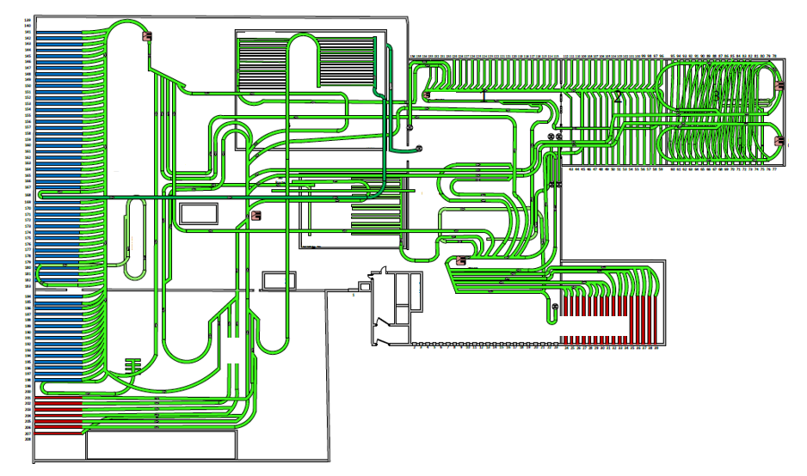
Sample Cross-Dock DC

Slide 3
In large-scale distribution centers, the resource allocation decision, or which doors to assign to staff, is difficult due to high volatility in carton volume
Examples of Volume Fluctuation
At a single door over time
Carton volume routed to a single door varies widely throughout the day. In one hour there could be 200 cartons and 20 in the next hour.
Across entire sets of doors at any given time
Volume across an entire set of doors varies widely at any given time. One door could be receiving 200 cartons, while the next two doors receive nothing.
As a manager, how can I allocate my staff such that they can meet the productivity goal, when volume is constantly shifting?

Slide 4
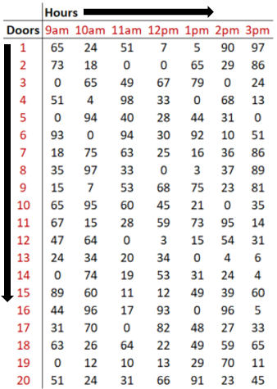
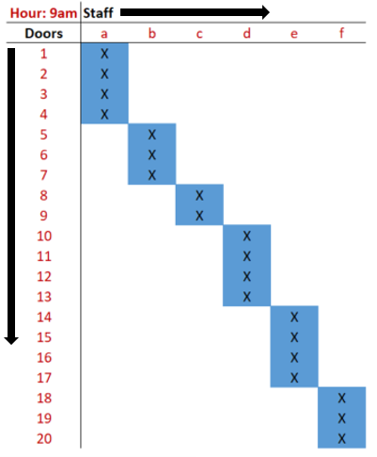



Distribute is a tool that helps floor managers make optimal decisions when allocating staff, enabling productivity to be maximized throughout the day
Staff-to-Door Allocation Process with Distribute
Data Input
Model Output
Allocation
Execution
Results
Distribute receives data from facility’s automated sorting system, showing where cartons will be routed over course of the next hour.
Distribute creates a report for the management team that contains optimal assignments of staff to sets of doors over the next hour.
Managers inform staff of their door assignments for the next hour.
Staff members work their assigned sets of doors until the next assignment.
Productivity increases, improving facility performance and minimizing labor cost.

Slide 5
A sample run of Distribute against actual productivity metrics suggests that there is significant value in leveraging this data to make better decisions
Distribute was run for a month, one hour at a time, using real volume data at a large distribution facility. Model results were compared to the actual hourly productivity results for those hours.
The recommended decisions by the model yielded productivity results as much as 18% higher than staff had been achieving with traditional techniques.
The model always found a way to assign sets of doors to associates to keep them at or above the target unless there simply was not enough work to do.
Productivity results were more stable and predictable over time, partially a result of smoothing out the volume

Slide 6
Ideal Distribute customer
Distribute is most valuable for facilities that generally meet the following criteria:
Need for Improvement
There is a need to significantly improve the allocation of scarce resources, because the current approach is not yielding expected results. For some facilities this may mean:
Productivity metrics are suffering or inconsistent
Productivity metrics are not being tracked and management is seeking a solution
Employees are experiencing a constant tug-of-war for their time
Decision Complexity
Managers needs to make complex resource allocation decisions very quickly with several, sometimes thousands, of available options. Factors that affect the complexity of the decision process include:
Size of the workforce
Size of the facility
Volume processed by the facility in a typical day
Level of volatility in volume throughout the facility over time
Data Quality
The volume that will be routed to a particular area of the facility is either known before resource allocation decisions need to be made, or can at least be modeled/predicted accurately. If neither is possible, Distribute can be used as a benchmarking tool, comparing actual performance to a more realistic ideal state.

